Slide 1

Topic 7: Statistical Transformations with ggplot2

Slide 2
Course Overview
Topic | Description
Session 1
1 | Introduction to R and R Studio Cloud
2 | Exploratory Data Analysis: the tibble and ggplot2
3 | Functions, Vectors and Lists
4 | Introduction to Functionals with purrr
5 | Data Transformation I with dplyr
Session 2
6 | Data Transformation II with dplyr
7 | Statistical Transformation with ggplot2
8 | Advanced Functionals and Modelling with purrr
9 | Exploratory Data Analysis - Case Study using aimsir17

Slide 3
Defining Important Terms (Wickham and Grolemund)
Term | Explanation
Variable | A quantity, quality or property that you can measure
Value | The state of a variable when you measure it. The value of a variable may change from measurement to measurement
Observation (or case) | A set of measurements made under similar conditions (you usually make all of the measurements in an observation at the same time and on the same object). An observation will contain several values, each associated with a different variable.
Tabular data | A set of values, each associated with a variable and an observation. Tabular data is tidy if each value is placed in its own “cell”, each variable in its own column, and each observation in its own row. All the data in aimsir17 and ggplot2 is tidy data.

Slide 4
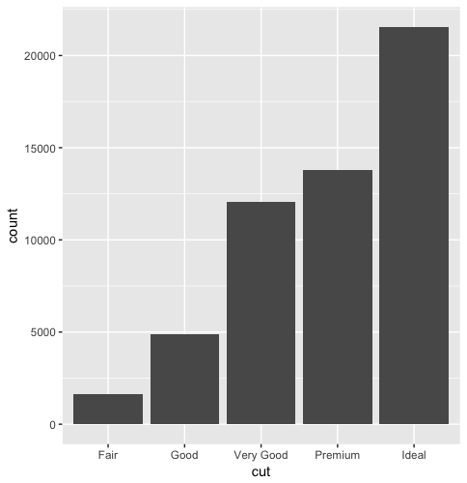
Variation
Bar Chart of Diamonds Data
Variation is the tendency of the values of a variable to change from measurement to measurement
If you measure a continuous variable twice, you can get two different results
For example, temperature at 12.00 and temperature at 13.00
Very variable has its own pattern of variation
The best way to understand the pattern is to visualize the distribution of a variable’s values.

Slide 5
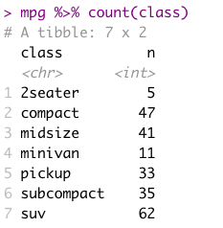
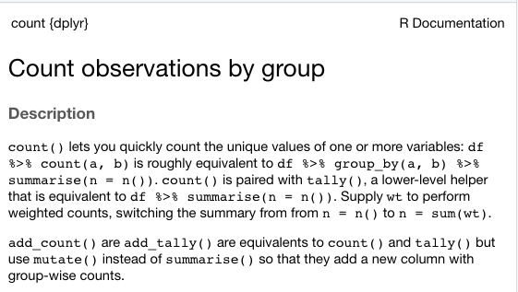
Useful function → dplyr::count()

Slide 6
Statistical Transformations
Many graphs, like scatterplots, plot the raw values of the dataset
However, other graphs (e.g. bar charts) calculate new values to plot
Bar charts, histograms and frequency polygons bin your data and plot bin counts, the number of points that fall in each bin
Smoothers fit a model to your data and the plot predictions from the model
Boxplots compute a robust summary of the distribution and display a specially formatted box

Slide 7
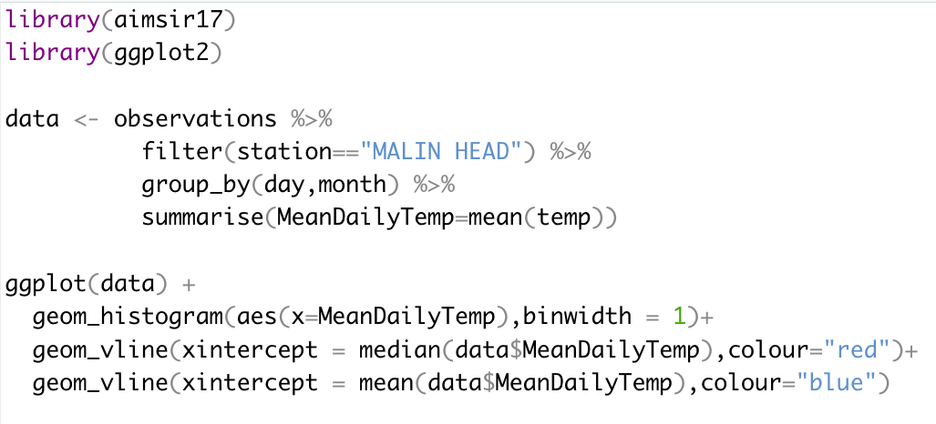
Histograms
A variable is continuous if it can take on any of an infinite set of ordinal values
Numbers are an example of a continuous variable
To examine the distribution of a continuous variable, use a histogram

Slide 8
Variation - Histogram
A histogram divides the x-axis into equally spaced bins, and uses the height of each bar to display the number of observations that fall into each bin
On the right, the total sum of all observation counts is 365.
The bin width can be varied.
geom_freqpoly() can also be used

Slide 9
Histogram - Interpretation
Tall bars show the common values of a variable, shorter bars show less common values
Places with no bars reveal values that were not seen in your data
Some useful questions
Which values are most common? Why?
Which values are rare? Does it match your expectation?
Can you see any unusual patterns? What might explain them?

Slide 10
Challenge 9.1
Generate a histogram for maximum daily windspeed (MACE HEAD)

Slide 11
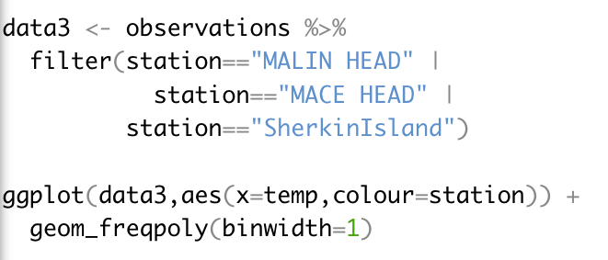
Two Station Comparison – geom_freqpoly()

Slide 12
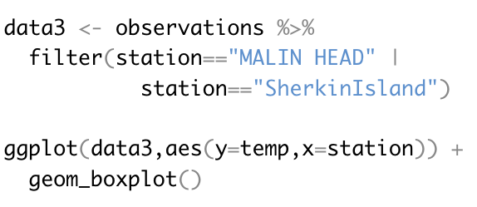
Comparing Distributions - boxplot

Slide 13
Covariation
If variation describes the behaviour within a variable, covariation describes the behaviour between variables
Covariation is the tendency for the values of two or more variables to vary together in a related way.
The best way to spot covariation is to visualize the relationship between two or more variables
We will explore covariation between continuous variables

Slide 14
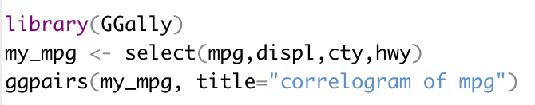
mpg data set

Slide 15
Challenge 9.2

Slide 16
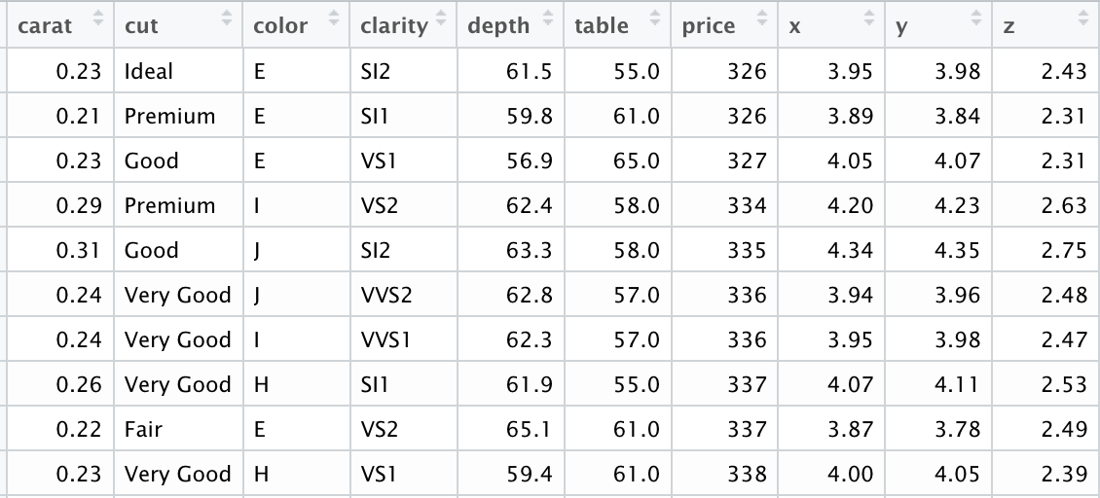
diamonds data set (ggplot2)
A dataset containing the prices and other attributes of almost 54,000 diamonds.

Slide 17
Explanation of variables
Feature | Explanation
price | price in US dollars $326–$18,823
carat | weight of the diamond (0.2–5.01)
cut | quality of the cut (Fair, Good, Very Good, Premium, Ideal)
color | diamond colour, from J (worst) to D (best)
clarity | a measurement of how clear the diamond is (I1 (worst), SI1, SI2, VS1, VS2, VVS1, VVS2, IF (best))
x | length in mm (0–10.74)
y | width in mm (0–58.9)
z | depth in mm (0–31.8)
depth | total depth percentage = z / mean(x, y) = 2 * z / (x + y) (43–79)
table | width of top of diamond relative to widest point (43–95)

Slide 18
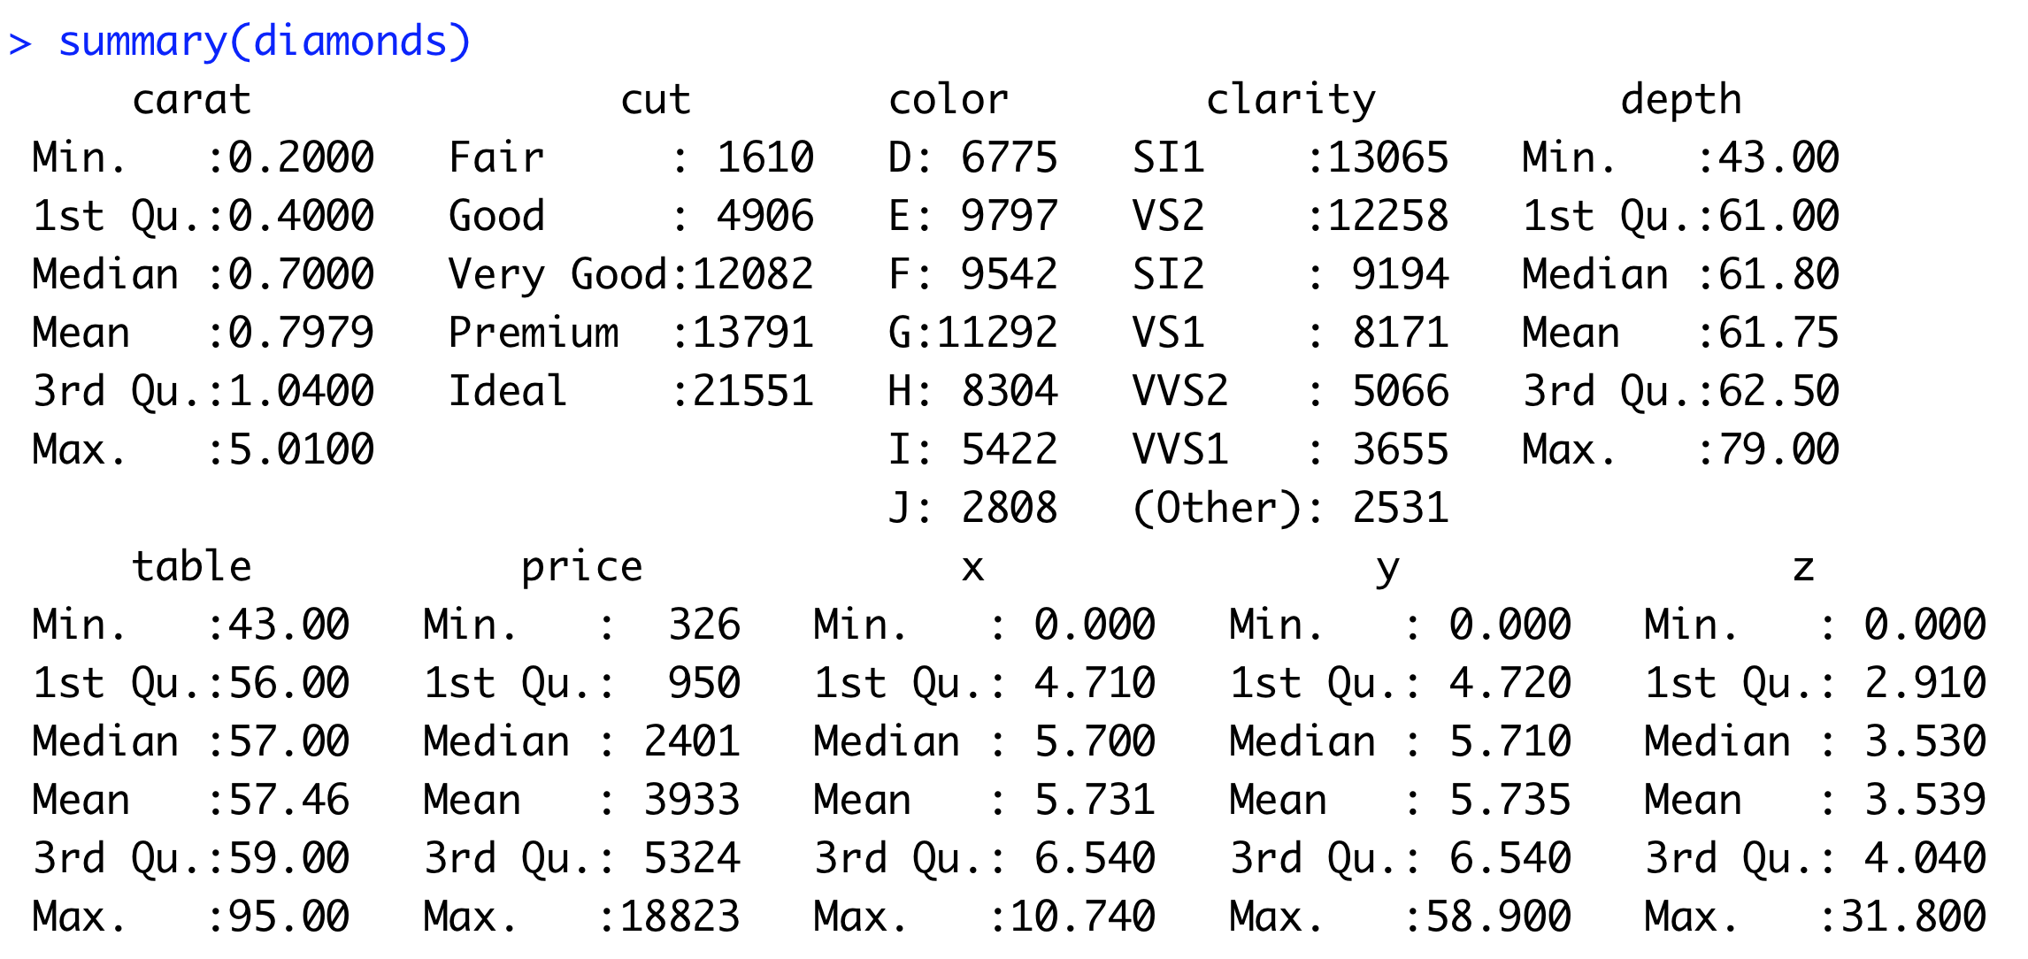
Summary of dataset

Slide 19
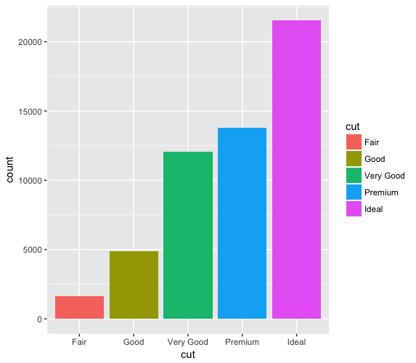
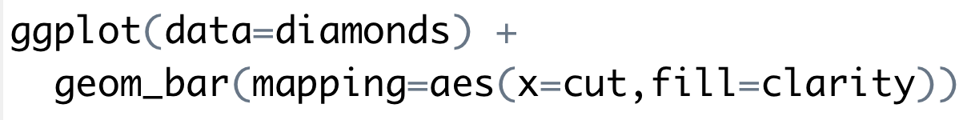
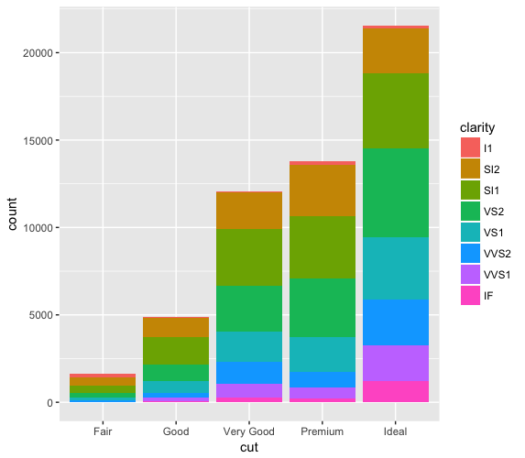
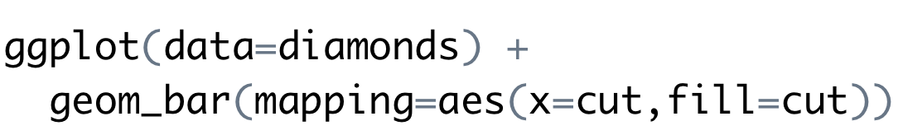
fill aesthetic for bar charts
Bar charts can be coloured using the fill aesthetic
When a different variable is used, the graph has further detail

Slide 20
Stacking options
Stacking is performed automatically by the position adjustment specified by the position argument
Examples include “identity”, “fill” and “dodge”
“fill”
Works like stacking, but each stacked bar is the same height
Makes it easier to compare proportions
“dodge”
Places objects directly beside one another
Makes it easier to compare individual values

Slide 21
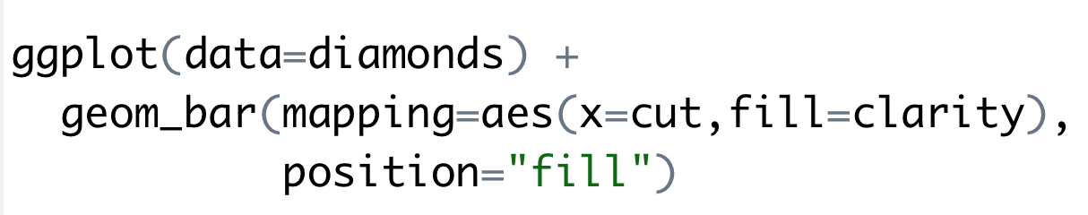
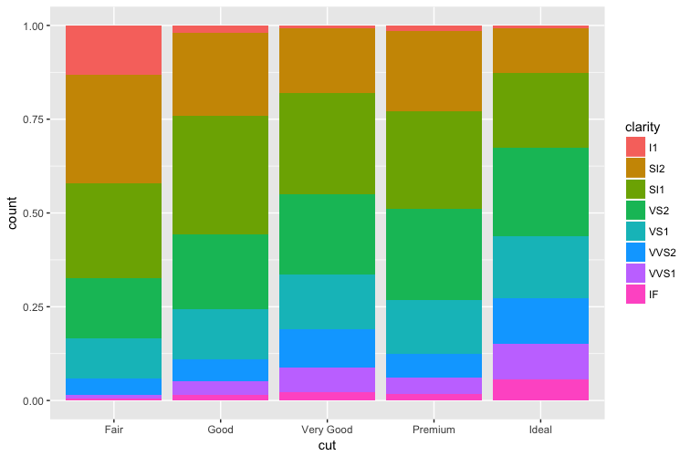

Slide 22
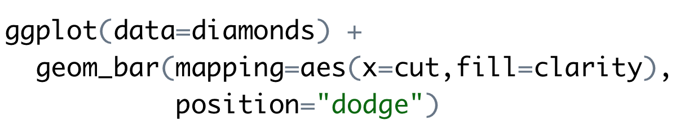
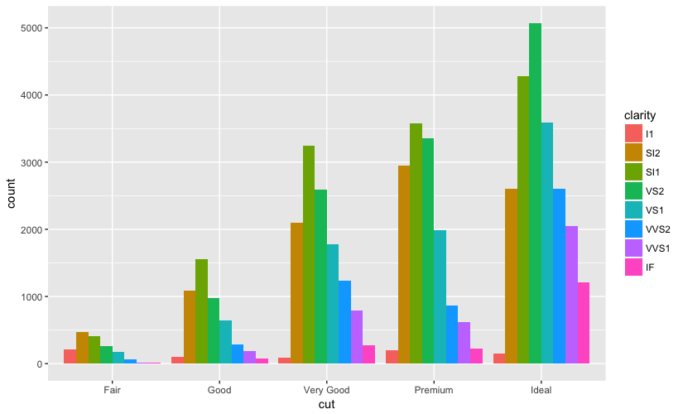

Slide 23
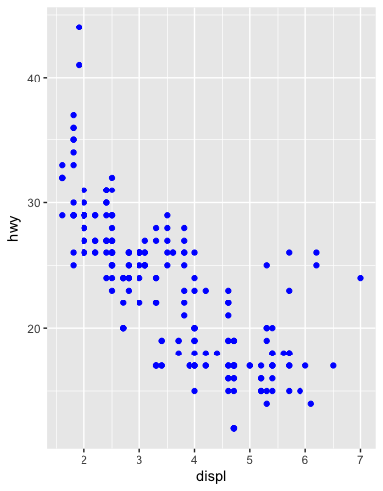
Additional adjustment
Recall our first scatterplot
126 points displayed, yet there are 234 observations
Many points can overlap, so it makes it hard to see where the mass of data is
Are all points spread equally, or is there one special combination that contains 129 values?
“jitter” adds random noise to each point.

Slide 24
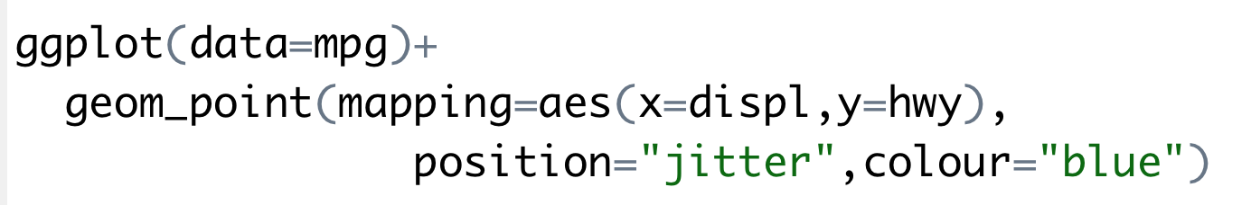
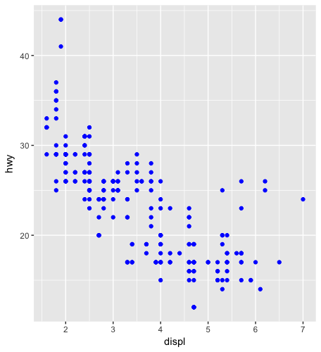
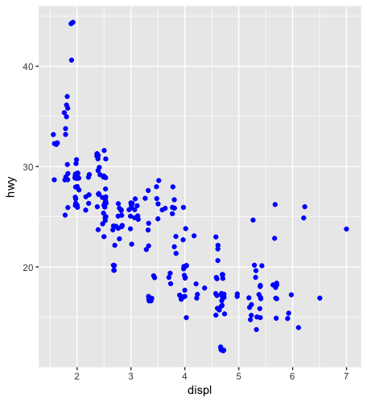

Slide 25
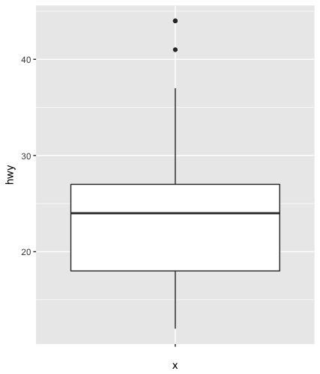
Boxplot
Display the distribution of a continuous variable broken down by a categorical variable
Box that stretches from the 25th to 75th percentile a distance known as the interquartile range (IRQ)
Median in the middle of box
Points outside more that 1.5 times the IQR from either edge of the box are displayed (outliers)
Whisker extends to the farthest non-outlier point in the distribution

Slide 26
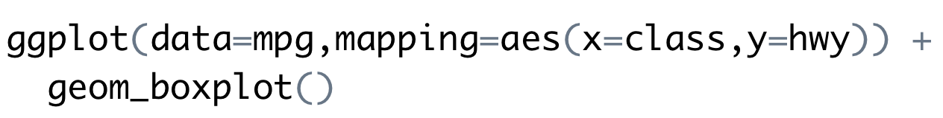
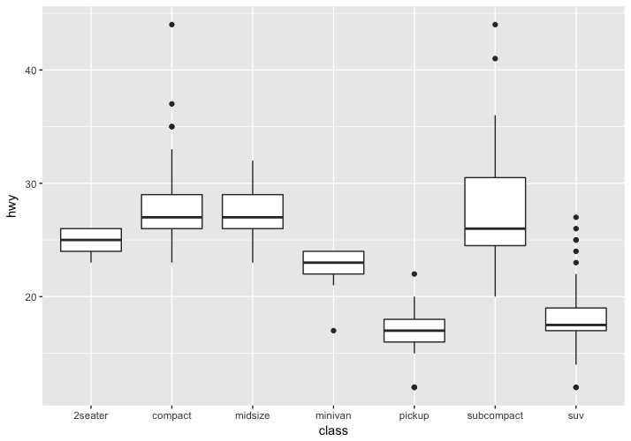

Slide 27
The Layered Grammar of Graphics
The ggplot2 approach can be summarised by a template
It can take seven parameters, but usually not all need to be applied (defaults used)
These seven parameters compose the grammar of graphics
ggplot(data=<DATA>) +
<GEOM_FUNCTION>(
mapping=aes(<MAPPINGS>),
stat=<STAT>,
position=<POSITION>
) +
<COORDINATE_FUNCTION>+
<FACET_FUNCTION>

Slide 28
Challenge 7. aimsir17 Exploration
Use the data set in aimsir17 to generate:
Time series data
Scatter plot
Bar charts
Box plots
Histograms
Enhance the graphs using aesthetics such as colour, fill, size
Break out the graphs using the facet_ functions

Slide 29
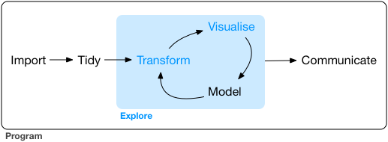
Summary
“Data exploration is the art of looking at your data, rapidly generating hypotheses, quickly testing them, then repeating again and again and again.” (Wickham and Grolemund 2017).

